Slide 1
Scouting America
Leave No Trace Instructor Course

Slide 2
Age and Program Appropriate
Outdoor Activities

Slide 3
Objectives
Goals: As a result of this session, each participant will be able to:
Discuss Scouting America guidelines for age-appropriate outdoor activities.
Discuss when it is appropriate to introduce more intensive levels of Leave No Trace skills within the Scouting program.
Start the process of determining how to select appropriate outdoor settings to meet the outdoor needs, interests, and abilities of local units.

Slide 4
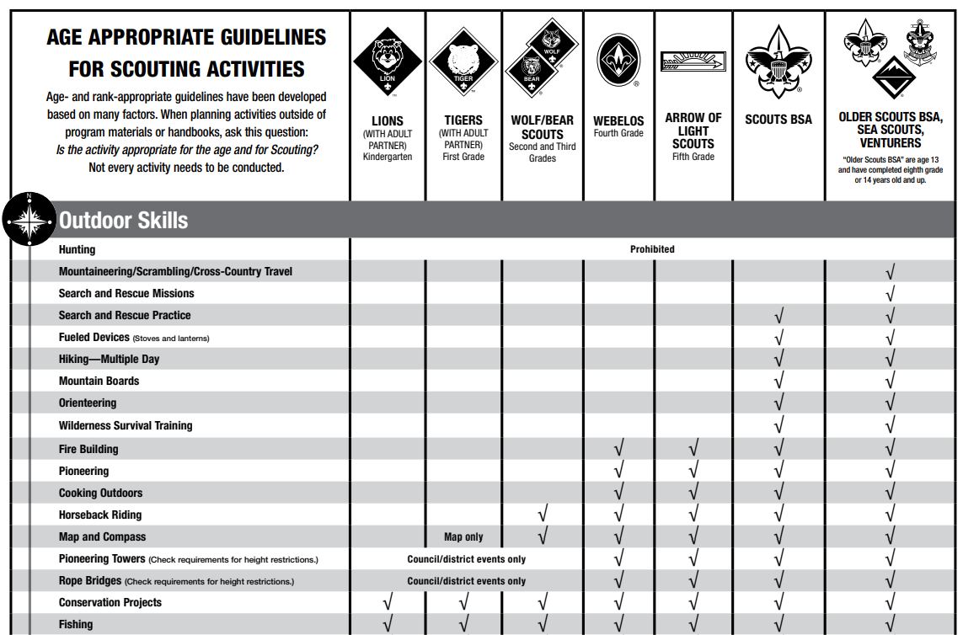
Age Appropriate Guidelines
Notes:
This chart is frequently updated, ensure to check for the most current version at: https://filestore.scouting.org/filestore/HealthSafety/pdf/680-685.pdf

Slide 5
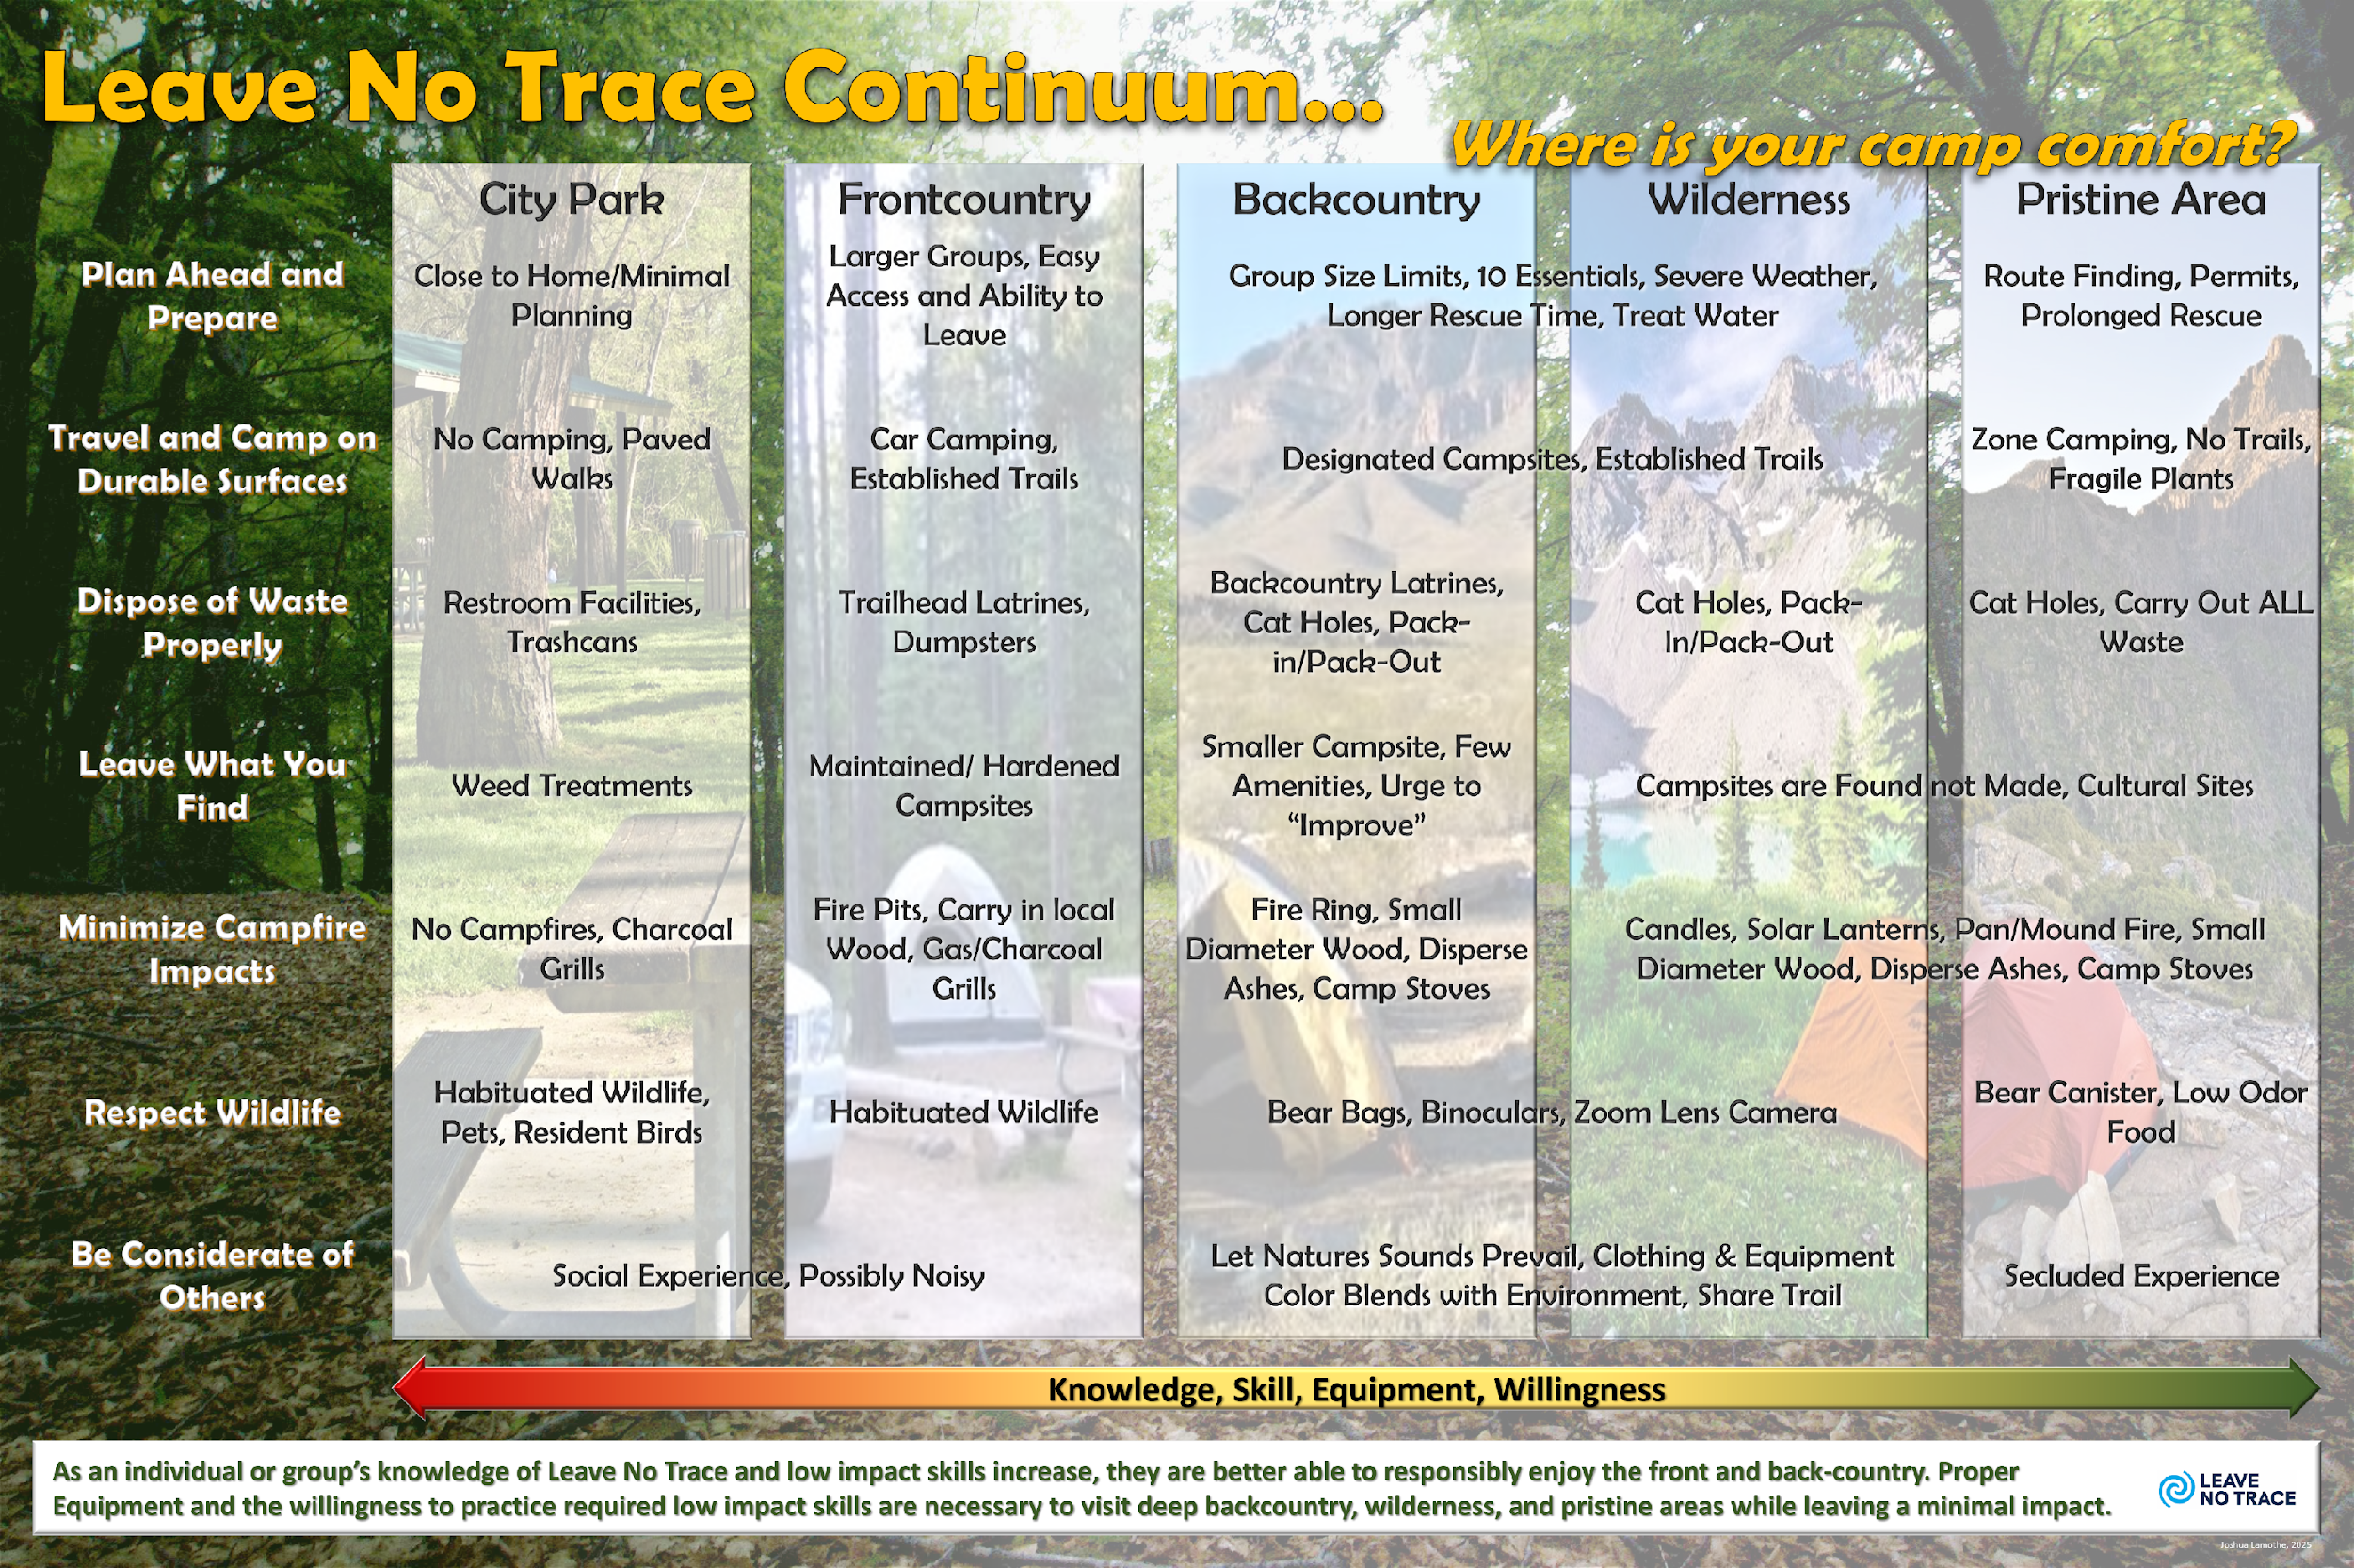

Notes:
When discussing age and program-appropriate outdoor activities, link this chart with the one on slide 4. Discuss how each program level in Scouting America recognizes the different abilities of youth at different ages and restricts activities that are above the typical skill and maturity level of younger Scouts.
Cover what Leave No Trace activities are most appropriate for each program in Scouting. While ‘Camp Oh No!” can be used with Cub Scouts and adults, “Exploring Campsite Selection” or digging cat holes would not be appropriate for Cub Scouts.
Have participates brainstorm and discuss the various outdoor programs of Cub Scouts, Scouts BSA, Venturing, and Sea Scouts participate in, the outdoor setting/location of the program, and Leave No Trace knowledge, skills, and equipment necessary to minimize impacts.
Then have participants brainstorm and discuss what activities from Bigfoot’s Playbook, 101 Ways to Teach Leave No Trace, or other sources, are most appropriate for each program level to teach the required knowledge and skills for the outdoor activities and settings applicable.

Slide 6
Age and Program Appropriate
Outdoor Activities

Slide 7
Prepared by
Joshua Lamothe
Revised: March 2025
Sources:
Scouting America Leave No Trace Instructor Supplement
Guide to Safe Scouting

